Slide 1
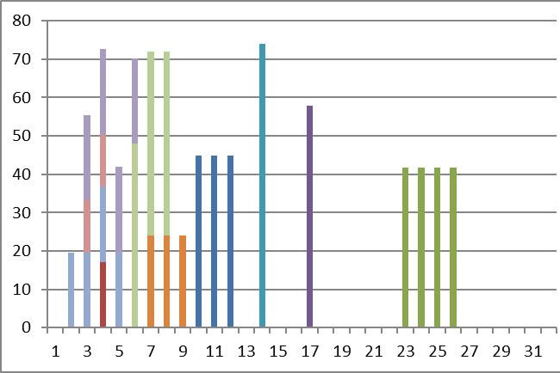
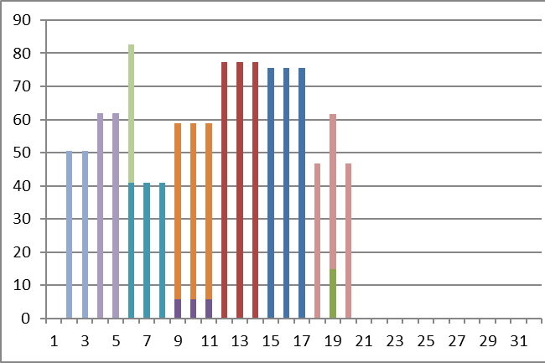
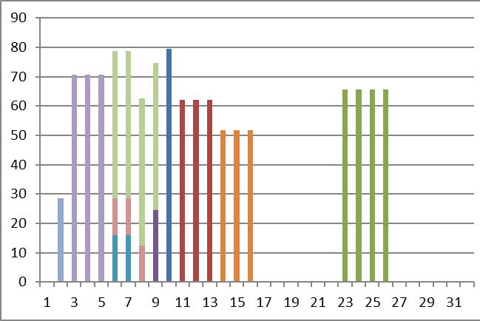
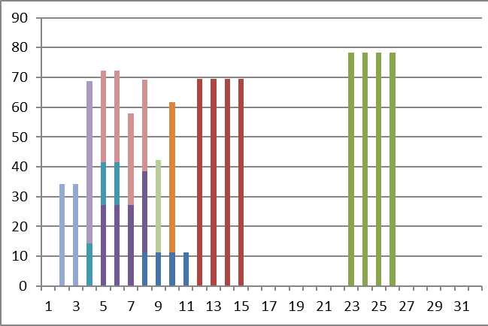
Resource 1, Order 1-10
Resource 2, Order 1-10
Resource 3, Order 1-10
Resource 4, Order 1-10

Slide 2
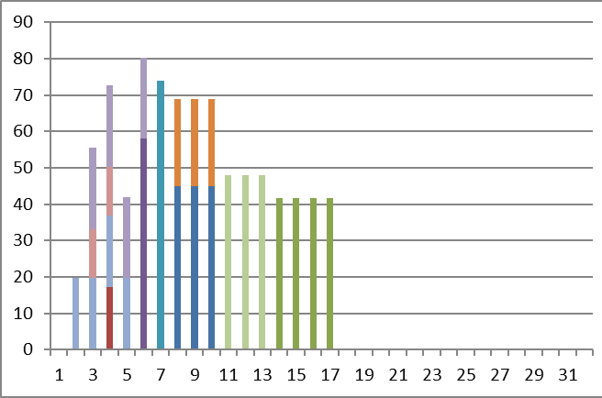
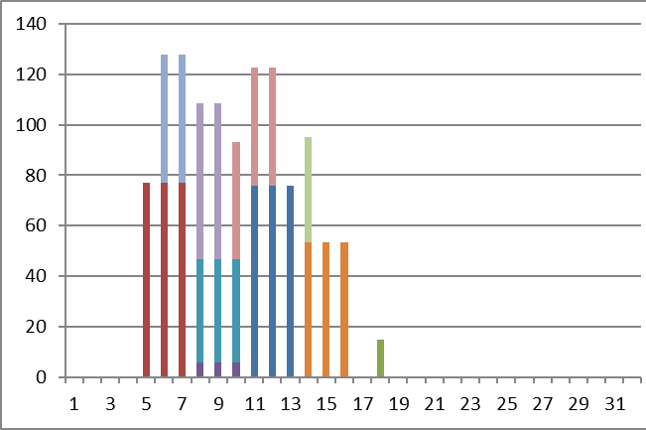
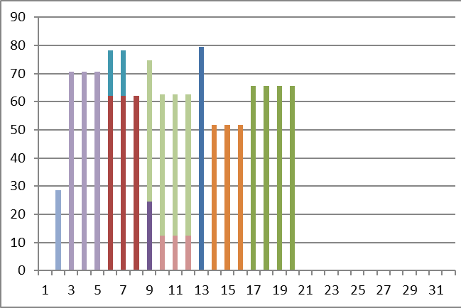
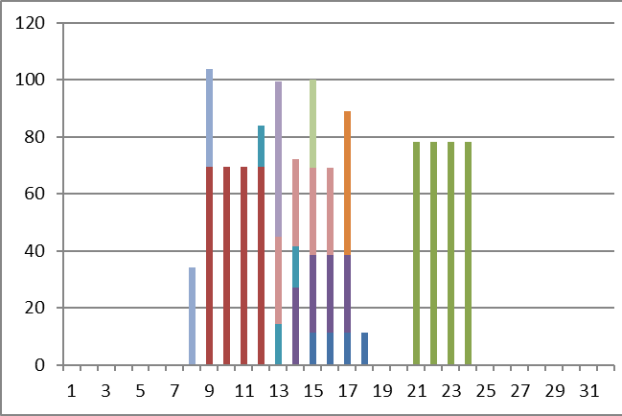
Resource 1, Order 1-10
Resource 2, Order 1-10
Resource 3, Order 1-10
Resource 4, Order 1-10

Slide 3
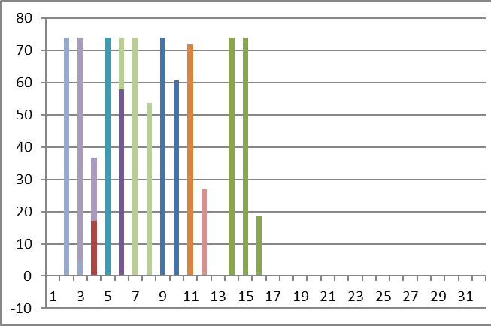
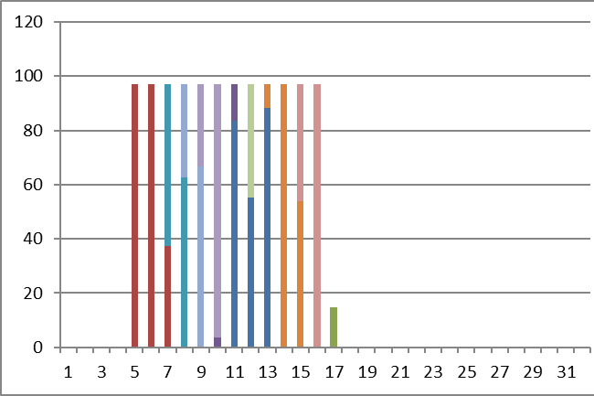
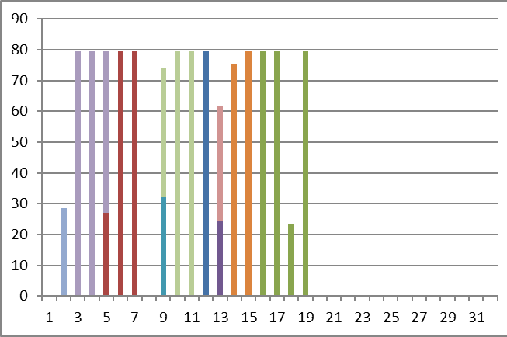
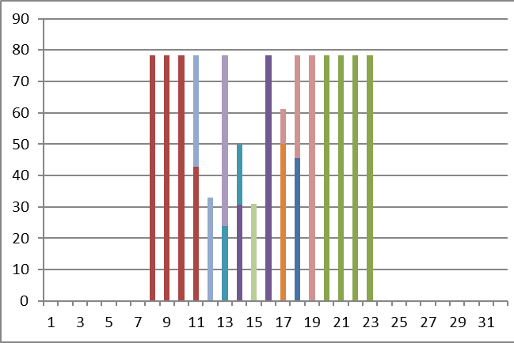
Resource 1, Order 1-10
Resource 2, Order 1-10
Resource 3, Order 1-10
Resource 4, Order 1-10

Slide 4
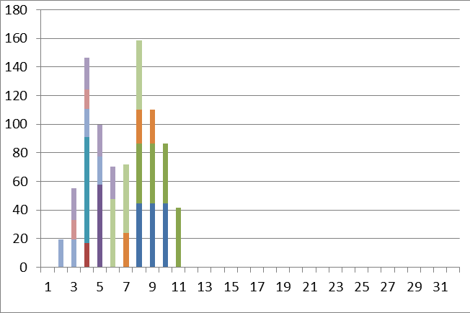
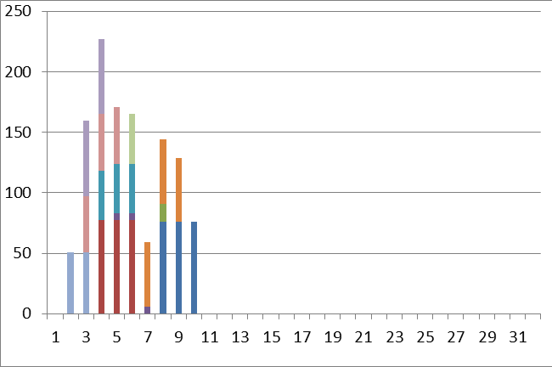
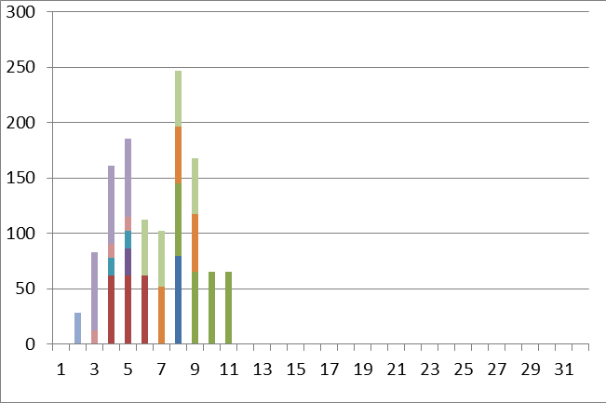
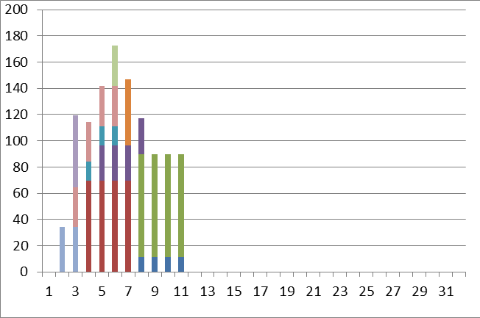
Resource 1, Order 1-10
Resource 2, Order 1-10
Resource 3, Order 1-10
Resource 4, Order 1-10

Slide 5
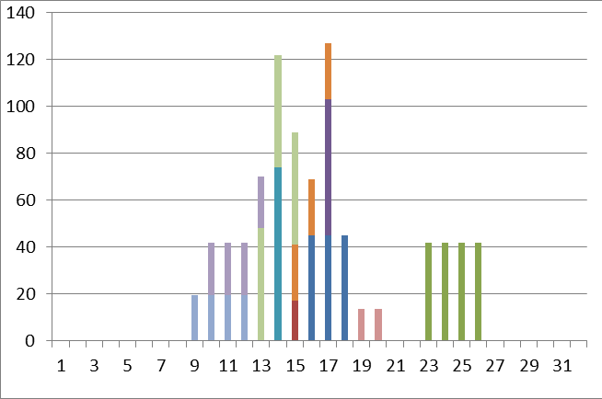
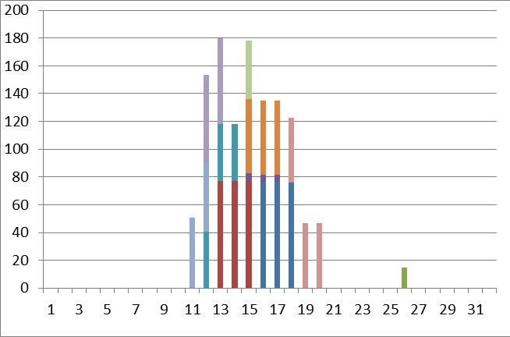
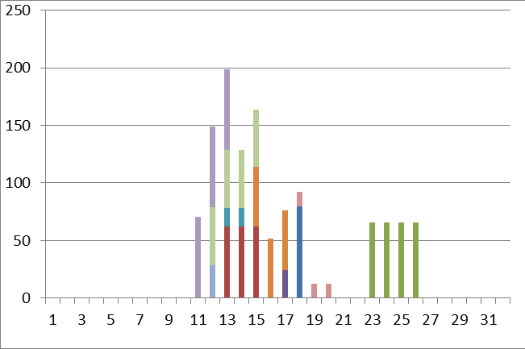
Resource 1, Order 1-10
Resource 2, Order 1-10
Resource 3, Order 1-10
Resource 4, Order 1-10

